Slide 1
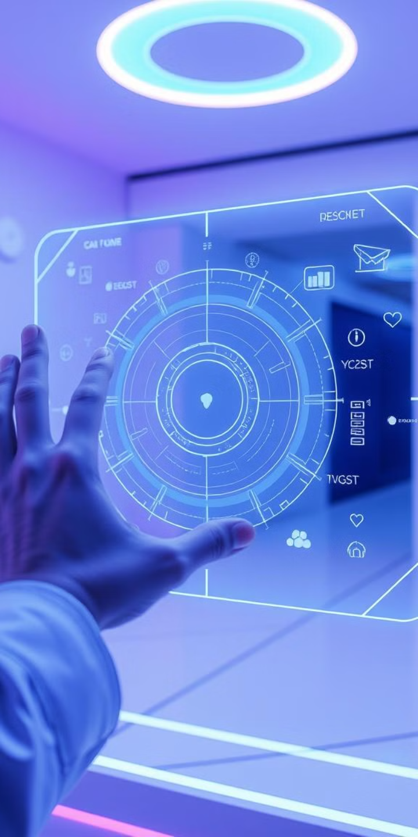

Gesture-Based Human-Computer Interaction System
Welcome to GestureX's presentation on our gesture-based human-computer interaction system, developed for this year's hackathon. Our team has created an innovative solution to address hygiene concerns and accessibility challenges in public interactive systems. We aim to revolutionize how people interact with technology in public spaces.
by Bhuvana Reddy

Slide 2
Addressing the Need for Touchless Interaction
Hygiene Concerns
Accessibility Limitations
Traditional kiosks and public interfaces require physical contact, which poses a significant hygiene risk. Germs and bacteria can easily spread through shared surfaces, leading to health concerns and reluctance to use such systems.
Many public kiosks are not fully accessible to individuals with disabilities. People with mobility impairments or those who have difficulty with touch-based interactions face challenges in using these systems effectively.
Our touchless AI-powered kiosk system solves these problems by providing a seamless and hygienic interaction method. Users can interact with the system using simple hand gestures, eliminating the need for physical contact.

Slide 3

Key Challenges in Public Interaction Systems
1
Germ Transmission
2
Limited Accessibility
Physical contact with public surfaces is a major source of germ transmission, affecting public health and safety.
Current systems often lack accessibility features for differently-abled individuals, creating barriers to access.
3
Inefficient Interactions
Traditional interfaces can be slow and cumbersome, leading to user frustration and longer transaction times.
Our system directly addresses these challenges by providing a safer, more accessible, and more intuitive interaction method. By reducing physical contact and improving accessibility, we can create a better experience for all users.

Slide 4
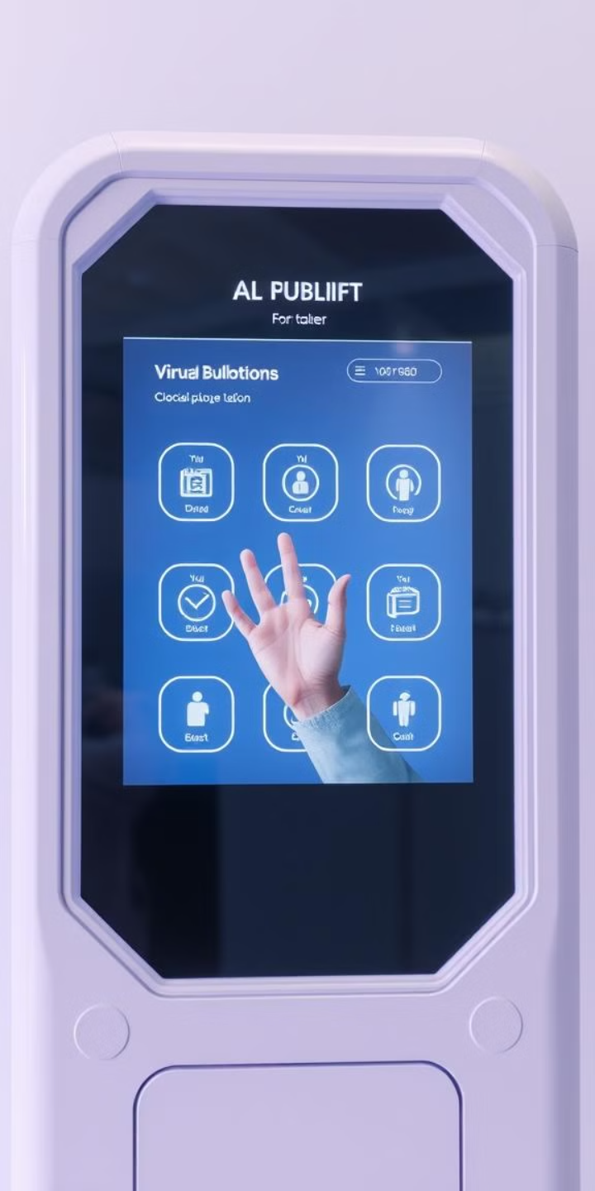



Our Proposed Solution: AI-Powered Gesture Recognition
Intuitive Gestures
Multilingual Support
Real-time Feedback
Our system uses AI to recognize natural hand gestures like swiping, pointing, and selecting.
The system supports multiple languages and customizable gesture sets for diverse users.
Voice and visual feedback ensures users are aware of their actions, enhancing the user experience.
Our innovative approach combines AI and computer vision to create a touchless interaction system that is both intuitive and accessible. This technology can be applied in a variety of public settings.

Slide 5
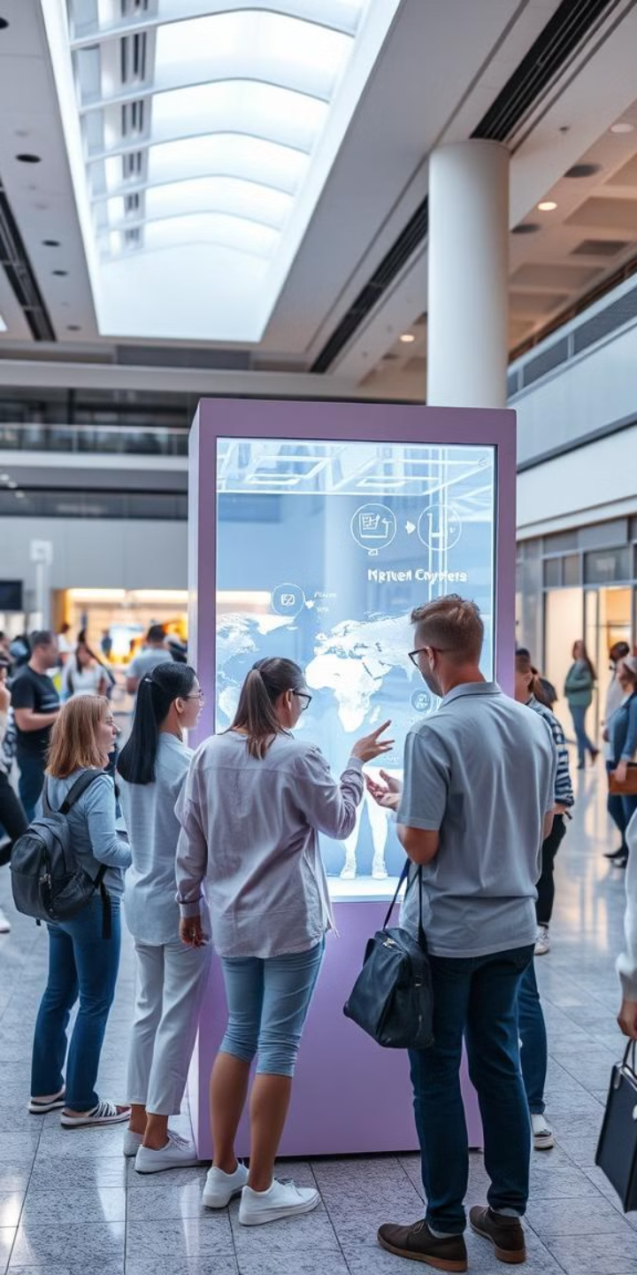
Target Users and Diverse Use Cases
Airports & Transit
Access information and services without touching screens, enhancing hygiene and convenience for passengers.
Museums & Exhibitions
Create interactive digital exhibits that engage visitors in a touchless and immersive way.
Retail & Malls
Enable hands-free browsing and product selection, improving the shopping experience for customers.
Public Spaces
Reduce physical contact in public areas, promoting better hygiene and safety for everyone.
Our system can benefit a wide range of users, including travelers, museum visitors, shoppers, and individuals with disabilities. By adapting our technology to different environments, we can create more accessible and hygienic public spaces.

Slide 6





System Architecture: How It All Works
Gesture Detection
Depth-sensing cameras capture user hand gestures in real-time.
AI Processing
AI models (MediaPipe, OpenCV, TensorFlow) process gestures and translate them into commands.
Backend Translation
Backend system translates gestures into corresponding UI actions.
Frontend Feedback
Frontend displays real-time feedback through voice and visuals.
The system architecture is designed to be modular and scalable, allowing for easy integration with existing kiosk systems. Our AI models are trained to recognize a variety of hand gestures, ensuring a smooth and intuitive user experience.

Slide 7
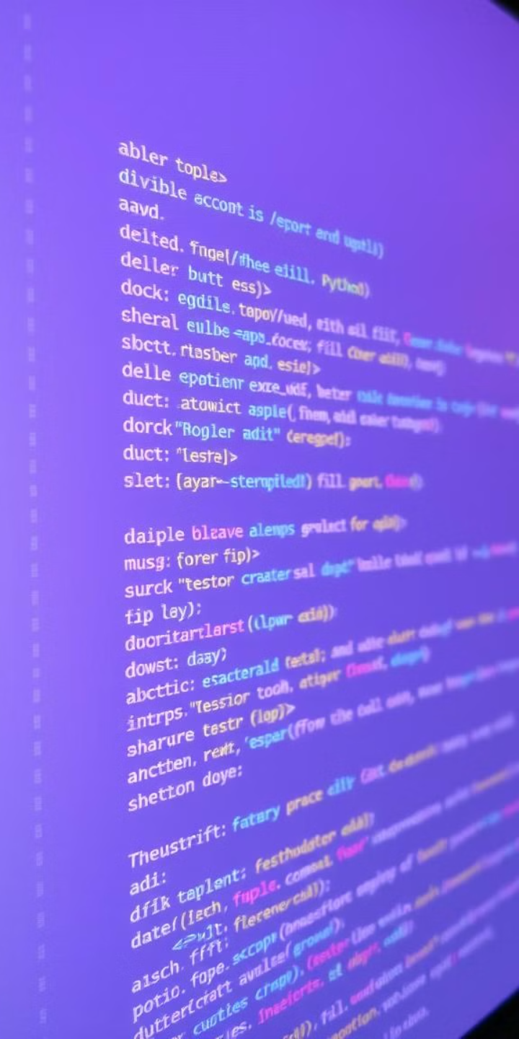
Technology Stack: Tools and Frameworks
Programming Languages
Python, JavaScript
Frameworks
React.js, Streamlit
AI Tools
MediaPipe, OpenCV, TensorFlow
Hardware
Depth-sensing camera (Leap Motion, Intel RealSense)
Our technology stack includes a combination of open-source tools and industry-standard frameworks. This allows us to leverage the latest advancements in AI and web development, ensuring a robust and scalable system. React.js ensures high performance and a great user experience.

Slide 8



Development Process and Challenges Faced
Gesture Mapping
2
Mapping gestures to specific commands required careful consideration.
AI Training
1
Training AI models for accurate gesture recognition was a key step.
UI/UX Design
3
Designing a user-friendly interface for touchless interaction was crucial.
We encountered several challenges during the development process, including ensuring gesture accuracy in varying lighting conditions and optimizing the system for real-time performance. However, through rigorous testing and iterative design, we were able to overcome these obstacles.

Slide 9
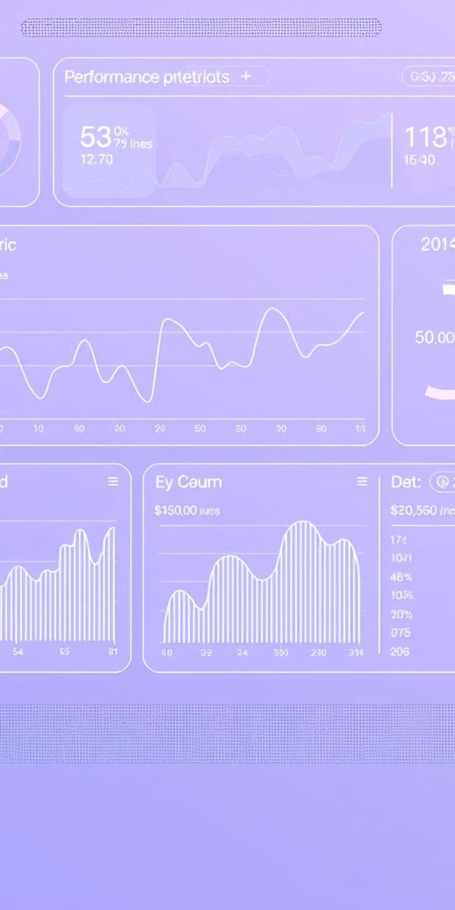
Testing and Performance Results
98%
< 100ms
Accuracy
Response
Gesture recognition accuracy rate.
Average API response time.
100%
Compatibility
UI compatibility across devices.
Our system underwent rigorous functional and performance testing to ensure accuracy, speed, and compatibility. We achieved a high gesture recognition accuracy rate and optimized the API for fast response times. The UI is designed to be compatible across different devices.

Slide 10
Conclusion: Impact and Future Scope
1
Safer Interactions
2
Faster Interactions
3
Inclusive Interactions
Our gesture-based human-computer interaction system provides safer, faster, and more inclusive interactions for public spaces. Future enhancements include expanding to more applications, improving AI for predictive gestures, and integrating voice commands. Thank you.

